Slide 1

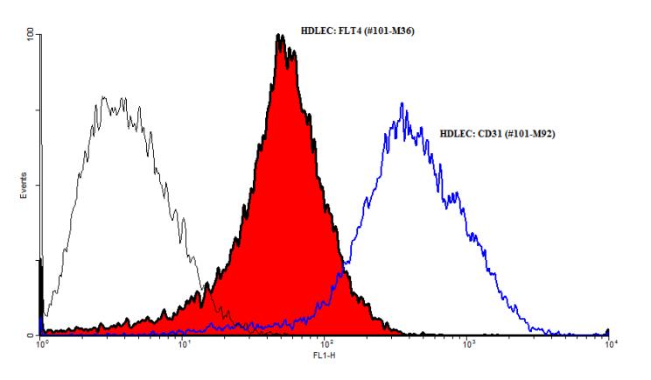
ReliaTech GmbH
Mouse anti-human VEGFR-2/KDR
(Cat #101-M22 / 101-M34)
Fig. 1: FACS analysis with primary human dermal lymphatic endothelial cells (HDLEC).
http://www.reliatech.de / orders@reliatech.de

